Slide 1
Capstone Project: Analytical CRM Development for a Bank
SUBMITTED BY : HARMANPREET KAUR

Slide 2
INTRODUCTION
This analysis focuses on understanding customer churn patterns within a retail bank. By examining key factors such as demographics, geography, financial behavior, and customer engagement, the study aims to:
Identify who is leaving and why
Highlight high-risk customer segments
Develop data-driven strategies to reduce churn, improve service quality, and enhance overall customer satisfaction

Slide 3
OBJECTIVE
The aim of this project is to analyse customer demographics, financial profiles and behavioural patterns to identify the key factors driving customer churn. By uncovering these insights, the analysis seeks to:
Reduce customer attrition through targeted retention strategies
Improve service delivery efficiency across banking operations
Enhance overall customer satisfaction and loyalty

Slide 4

PROBLEM STATEMENT
You are an analytical CRM (Customer Relationship Management) specialist hired by a bank to extract meaningful insights from various customer-related datasets. The bank aims to reduce customer churn, improve service delivery, and enhance customer satisfaction. They have provided you with datasets including customer demographics, transaction details, customer exit information, and active customer profiles.

Slide 5
DATA ATTRIBUTES The dataset contain information about 7 tables. Below is an overview of the dataset.
TABLES
CustomerInfo – Contains customer demographic information.
Bank Churn – Stores churn status and banking details.
Credit Card – Indicates whether the customer owns a credit card.
Active Customer – Shows customer activity status.
Geography – Contains customer country information.
Gender – Lookup table for gender names.
Exit Customer – Contains exit/churn-related information.
KEY COLUMNS
CustomerId
CreditScore
Age
Gender
Geography
Balance
Estimated Salary
Tenure
Number of Products
Has Credit Card
Is Active Member
Exited

Slide 6
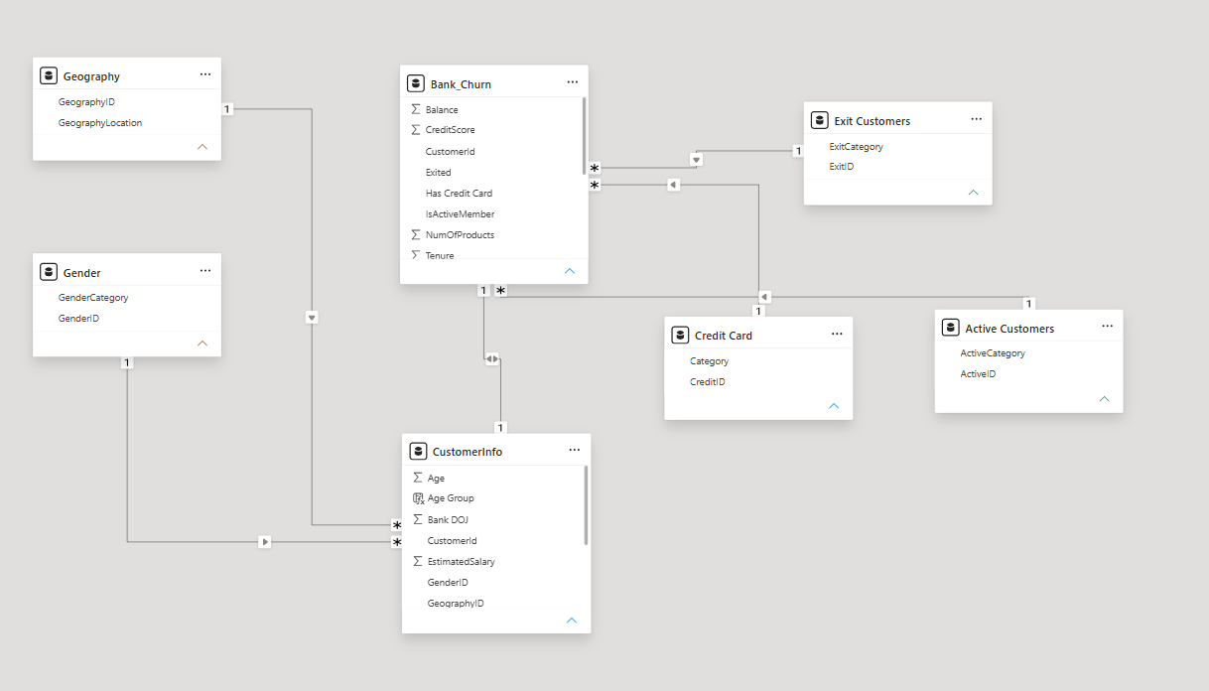
DATA MODEL

Slide 7
DATA CLEANING AND TRANSFORMATION
Data Cleaning
Imported and validated 7 related datasets.
Checked for missing (null) values and handled them appropriately.
Checked duplicate records.
Verified and corrected data types (Text, Whole Number, Decimal, Date).
Standardized column names for consistency.
Ensured Customer ID uniqueness across all tables.

Slide 8
Data Transformation
Created relationships between all tables using CustomerId, GeographyID, and GenderID.
Developed a Star Schema data model for efficient reporting.
Created calculated columns:
Age Group
Salary Group
Active Category
Created DAX measures:
Total Customers
Exited Customers
Active Customers
Churn Rate
Average Credit Score
Average Balance
Applied conditional formatting to highlight high-risk churn customers.

Slide 9
INSIGHTS AND RECOMMENDATIONS

Slide 10

OVERALL CHURN RATE
Insights
Overall customer churn rate is 20.37%.
Around 1 in every 5 customers has left the bank.
Recommendations
Focus retention efforts on high-risk customer segments.
Monitor churn monthly through dashboards.

Slide 11
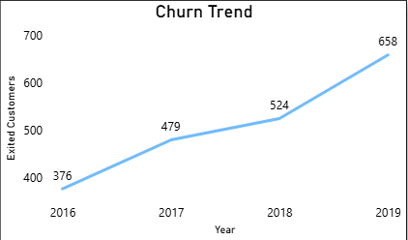
CHURN TREND (YEAR-WISE)
Insights
Customer exits increased steadily from 2016 to 2019.
Highest number of exits occurred in 2019.
Recommendations
Identify reasons behind the increasing churn trend.
Implement proactive retention strategies before churn rises further.

Slide 12
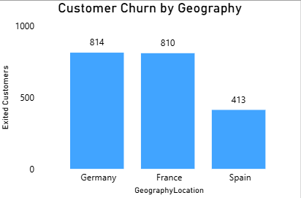
Customer Churn by Geography
Insights
Germany has the highest churn rate.
France and Spain have comparatively lower churn.
Recommendations
Investigate customer issues in Germany.
Introduce region-specific retention campaigns.

Slide 13
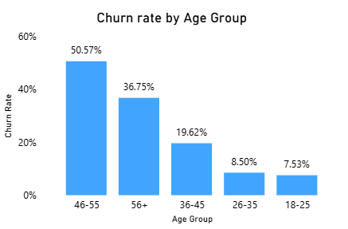
Churn Rate by Age Group
Insights
Customers aged 46–55 show the highest churn.
Younger customers (18–35) are more likely to stay.
Recommendations
Offer loyalty benefits for middle-aged customers.
Design personalized financial products for this segment.

Slide 14
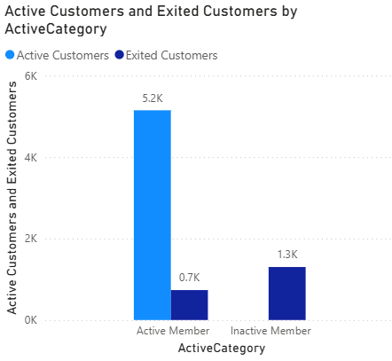
Active vs Inactive Members
Insights
Inactive members contribute significantly more to churn.
Active members are much more likely to remain customers.
Recommendations
Increase customer engagement through digital banking.
Encourage inactive users with personalized offers.

Slide 15
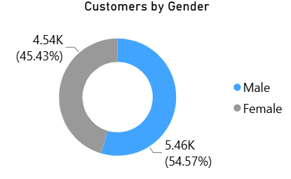
Customer Distribution by Gender
Insights
The customer base is well balanced, with 54.57% male (5.46K) and 45.43% female (4.54K) customers.
Male customers form a slightly larger share of the bank's customer base.
The difference is moderate, indicating the bank serves both genders effectively.
Recommendations
Continue offering gender-neutral banking services.
Analyse churn by gender for targeted marketing if needed.

Slide 16
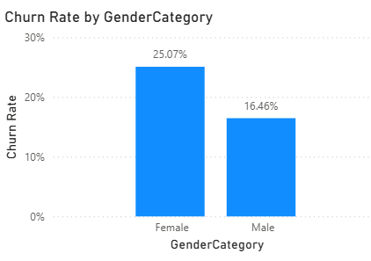
Customer Distribution by Gender
Insights
Female customers have a higher churn rate (25.07%) than male customers (16.46%), indicating they are more likely to leave the bank.
This suggests customer retention strategies may need to be tailored differently for female customers.
Recommendations
Introduce targeted loyalty programs and personalized offers for female customers to improve retention.
Regularly monitor churn by gender and use customer feedback to address the reasons behind higher female churn.

Slide 17
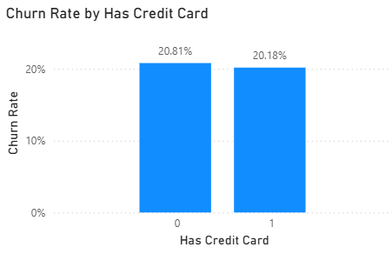
Churn Rate by Credit Card Status
Insights
Churn rates are almost identical for credit card holders and non-holders.
Credit card ownership alone does not significantly influence customer retention.
Recommendations
Enhance credit card reward programs and exclusive benefits.
Combine rewards with personalized offers to improve retention.

Slide 18
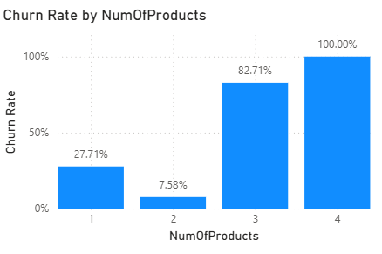
Churn Rate by Number of Products
Insights
Customers with 3–4 products have the highest churn rate.
Customers with 2 products show the lowest churn.
Recommendations
Review product bundles for customers with multiple products.
Improve service quality for premium customers.

Slide 19
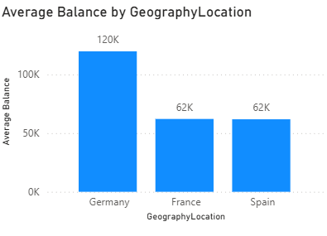
Average Balance by Geography
Insights
Germany maintain higher average balance.
Spain and France has comparatively lower customer balances.
Recommendations
Offer wealth management products in high-balance regions.
Promote savings and investment products in France and Spain.

Slide 20
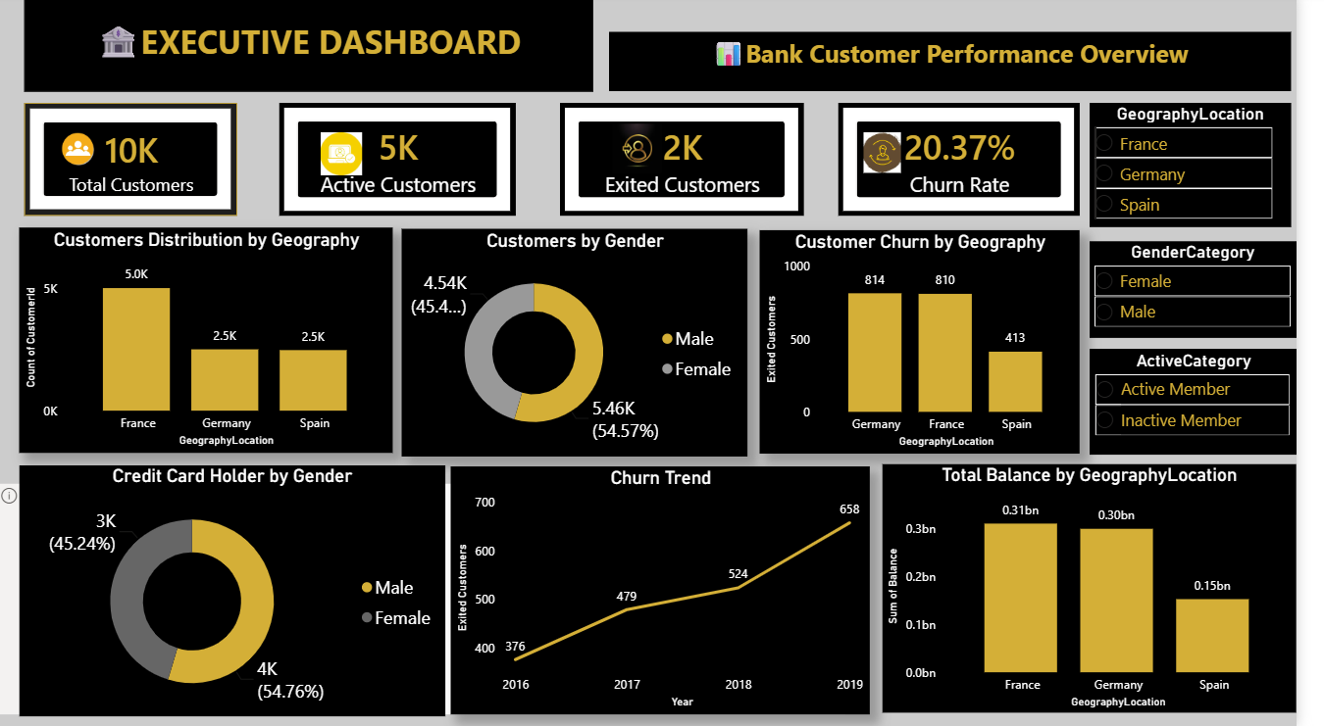
DASHBOARD

Slide 21
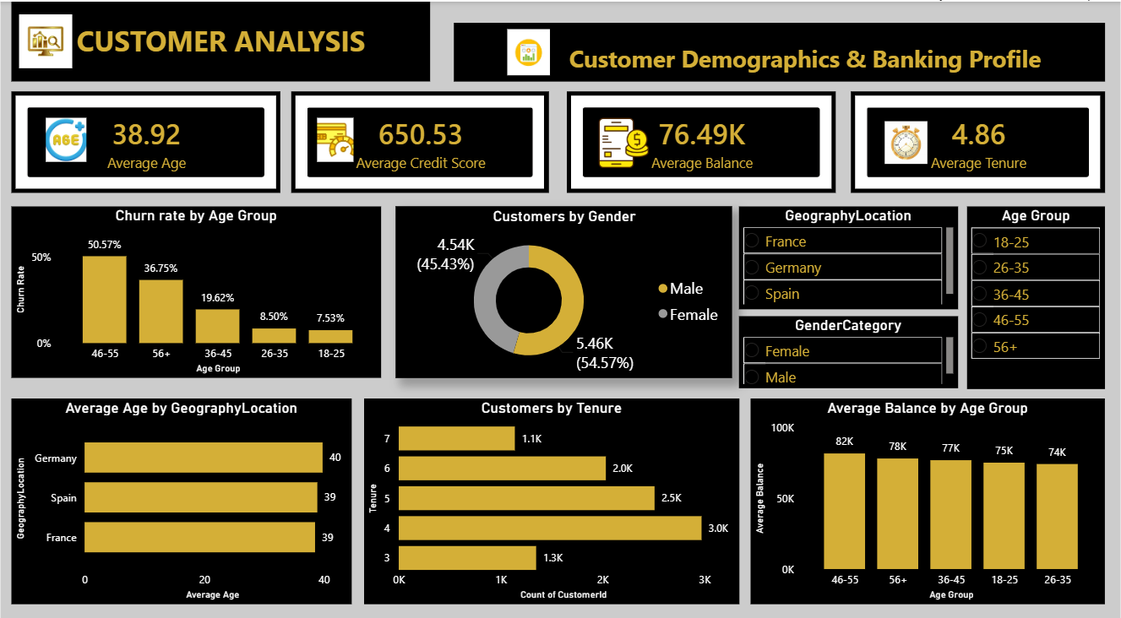

Slide 22
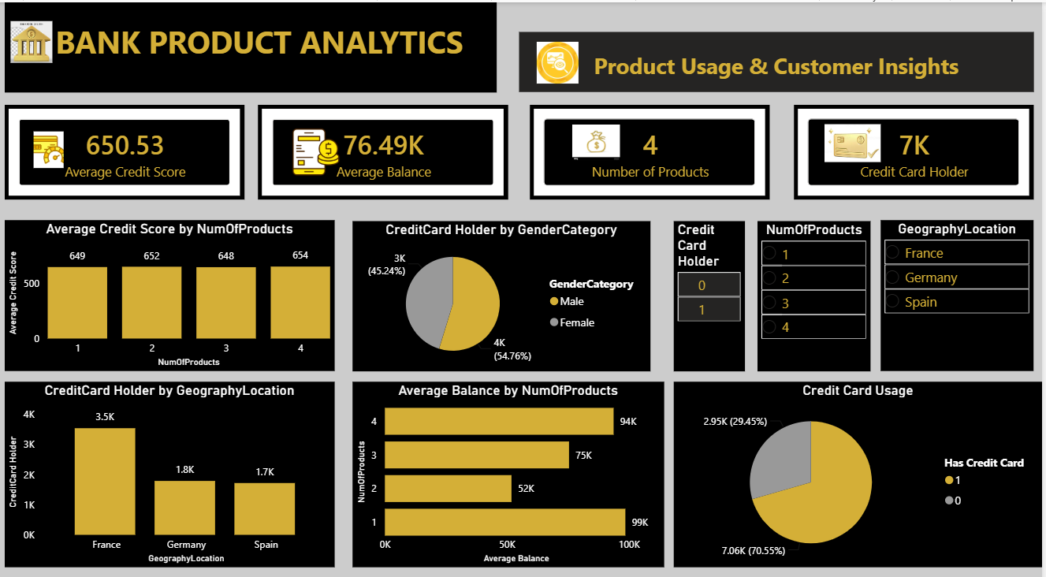

Slide 23
Data Challenges in Churn Analysis
Multiple Data Sources: Customer information was spread across 7 different tables, requiring proper relationships and data modelling.
Data Integration: Joining tables using CustomerId, GenderID and GeographyID while maintaining data consistency.
Identifying Churn Drivers: Determining which factors (age, geography, activity status, products, credit score, etc.) had the greatest impact on customer churn.
Performance Optimization: Used DAX measures and an optimized data model to ensure fast dashboard performance.
Business Interpretation: Converting raw data into actionable insights and recommendations for customer retention.

Slide 24
FINAL RECOMMENDATIONS
Strengthen customer retention
Enhance customer experience
Leverage data-driven decision making
Focus on high-risk customer segments, especially customers aged 46–55, inactive members and customers with high churn probability.
Introduce personalized offers, loyalty programs and proactive customer engagement to reduce churn.
Continuously monitor KPIs such as Churn Rate, Customer Activity, Product Usage and Credit Score through Power BI dashboards.
Use predictive analytics and targeted marketing campaigns to identify at-risk customers early and improve retention.
Improve service quality in high-churn regions, particularly Germany.
Collect regular customer feedback and resolve issues quickly to increase customer satisfaction and trust.

Slide 25
CONCLUSION
The Bank CRM Churn Analysis project successfully identified the key factors influencing customer churn using Power BI, DAX and SQL.
The analysis revealed that customer age, geography, activity status and number of products have a significant impact on churn while credit card ownership and salary have minimal influence.
Interactive dashboards and visualizations enabled the bank to monitor customer behaviour, identify high-risk customers and make informed business decisions.
By implementing targeted retention strategies, improving customer engagement and continuously monitoring key performance indicators, the bank can reduce churn, improve customer satisfaction and strengthen long-term customer relationships.

